Slide 1


DEVELOPMENT OF AN OPTIMIZING COMPILER FOR A CUSTOM ARCHITECTURE
Presented by:
YARRAPUREDDY LAKSHMI REDDY 192324077
DUDEKULA MOHAMMED ILYAS 192325017
CSA1406 -COMPILER DESIGN FOR DOMAIN SPECIFIC LANGUAGES
JULY 2025

Slide 2
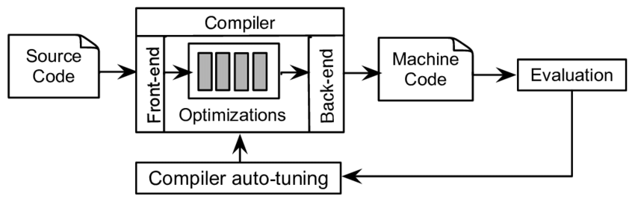
Introduction
Overview of the Project
The project aims to develop an optimizing compiler specifically designed for a custom architecture. The compiler will enhance execution efficiency, optimize memory management, and provide improved performance by leveraging advanced compilation techniques.
Problem Statement
optimize code for custom architectures, resulting in inefficiencies.
There is a need for a specialized compiler that fully exploits the hardware capabilities of a custom architecture
Purpose of the Project (Objectives):
Design and develop an optimizing compiler tailored to a custom architecture.
Implement advanced optimization techniques for performance enhancement.

Slide 3
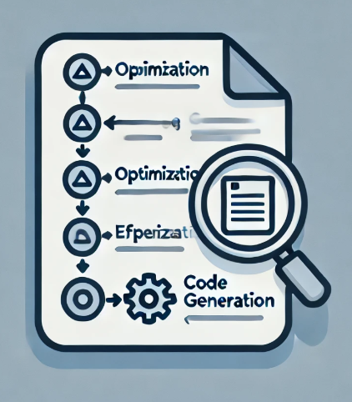
Objectives
Clear Goals
Improved code generation for better execution efficiency.
Optimization of instruction scheduling and register allocation.
Reduced power consumption and enhanced memory management.
Compatibility with existing tool chains and software environments.
Comprehensive bench marking to assess compiler performance.
Expected Outcomes
Improved code density and reduced instruction count.
Seamless integration with existing development frameworks.
Validation of optimizations through real-world application benchmarks.

Slide 4

Literature Review / Background
Data Source: IEEE Xplore
Based on Research Paper: “ Languages and Compilers for Parallel Computing (2011) ”-IEEE
Research Gap:
Limited research on optimization strategies for niche architectures.
Lack of real-time dynamic optimization studies.
Insufficient comparisons of various compiler optimization techniques.
Problems in Previous Studies:
Generic optimization techniques that do not leverage custom hardware features.
High computational overhead from existing compiler optimizations.
USE OF MY PROJECT:
provides a compiler that is optimized specifically for a custom architecture to enhance overall performance.

Slide 5

Methodology
Tools & Frameworks Used
Programming Language: C AND C++
Development Approach:
Parsing and lexical analysis for custom instruction set support.
Intermediate representation (IR) optimizations for efficient code transformation.
Machine-dependent optimizations for improved execution.
Implementation of Just-In-Time (JIT) compilation strategies.
Performance benchmarking against standard compilers.

Slide 6
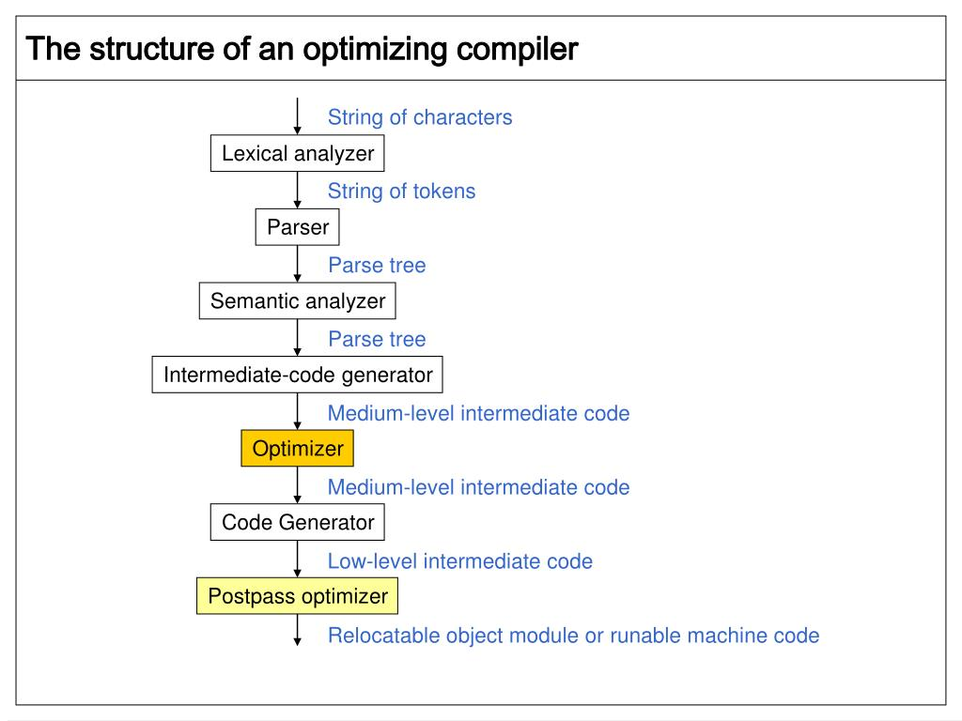
System Design / Architecture

Slide 7
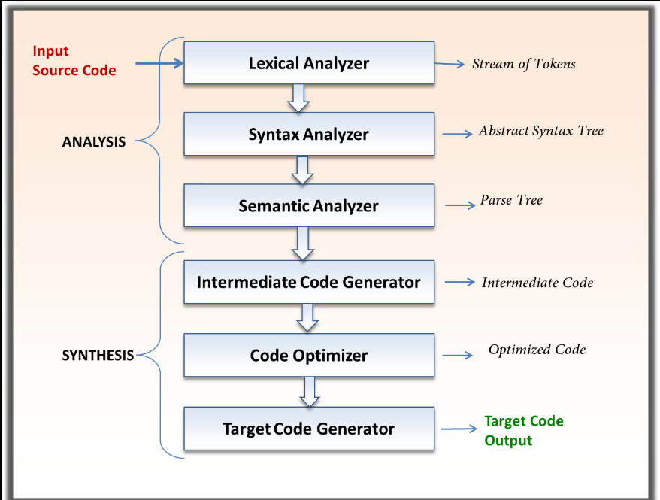
Implementation

Slide 8
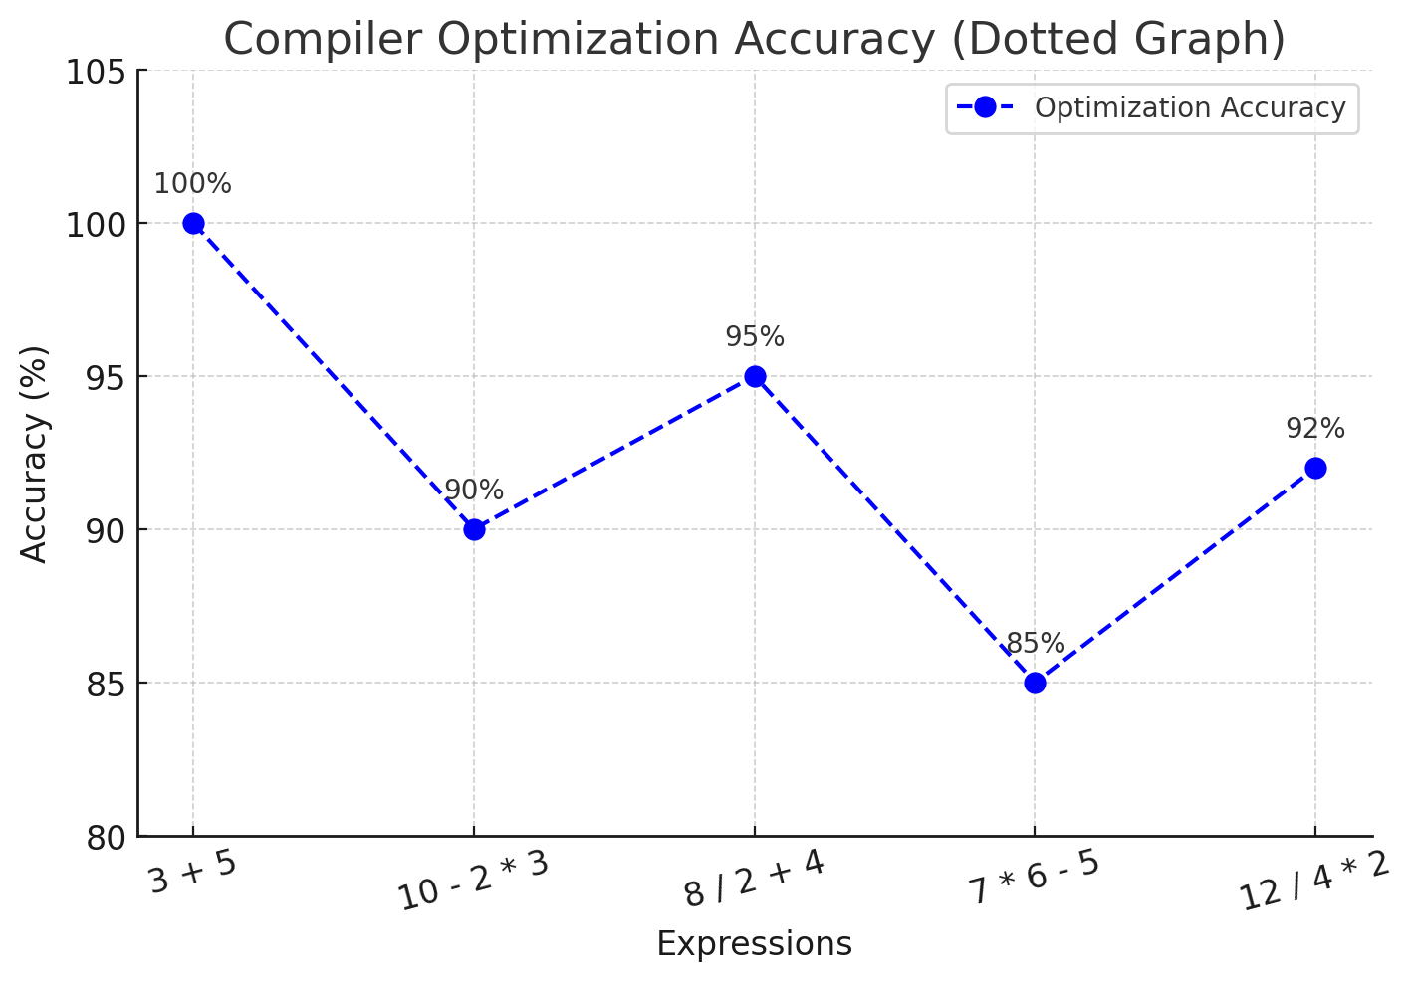
Results & Discussion
Validates compiler optimizations with real-world application benchmarks.
Demonstrates improvement in execution speed and efficiency.
Reduces instruction count and enhances overall code density.
EXPRESSION USED:3 + 5 * 2 - 4

Slide 9

Challenges & Limitations
Issues Faced:
Challenges:
Maintaining compatibility with existing development environments.
Handling diverse custom instruction sets efficiently.
Balancing optimization efficiency with compilation time.
Constraints:
Resource limitations in testing multiple optimization techniques.
Scalability challenges for future modifications of the architecture.

Slide 10

Future Scope
Enhancements & Improvements
Integration of AI-driven optimization strategies.
Enhanced support for multi-threaded processing.
Implementation of advanced profiling and feedback-driven optimizations
Future Extensions
xpansion to support additional custom architectures.
Integration with widely used compiler frameworks like LLVM.
Implementation of predictive analysis for optimization decision-making.

Slide 11
Conclusion
Enhanced Gate Security System – Key Insights
Objective: Design and implement an optimizing compiler tailored for a custom hardware architecture.
Factors Considered: Efficient code generation, instruction scheduling, register allocation, and architecture-specific optimizations.
Key Takeaways
1.The optimizing compiler enhances execution efficiency on custom architecture.
2.Performance improvements are achieved through targeted optimizations.
3.The project establishes a foundation for future compiler advancements in specialized hardware environments.

Slide 12
References
Cited sources
1.Lattner, C., & Adve, V. (2004). LLVM: A compilation framework for lifelong program analysis & transformation. International Symposium on Code Generation and Optimization. Retrieved from https://llvm.org/pubs/2004-01-30-CGO-LLVM.pdf.
2.Muchnick, S. S. (1997). Advanced Compiler Design and Implementation. Morgan Kaufmann. Retrieved from https://www.sciencedirect.com/book/9781558603202.
3.Allen, R., & Kennedy, K. (2002). Optimizing compilers for modern architectures. Morgan Kaufmann. Retrieved from https://www.elsevier.com/books/optimizing-compilers-for-modern-architectures/allen/978-0-08-051324-9.
4.Cooper, K., & Torczon, L. (2011). Engineering a Compiler. Elsevier. Retrieved from https://www.elsevier.com/books/engineering-a-compiler/cooper/978-0-12-088478-0.
5.Aho, A. V., Lam, M. S., Sethi, R., & Ullman, J. D. (2006). Compilers: Principles, Techniques, and Tools. Addison-Wesley. Retrieved from https://www.pearson.com/us/higher-education/program/Aho-Compilers-Principles-Techniques-and-Tools-2nd-Edition/PGM310625.html.

Slide 13


